Slide 1
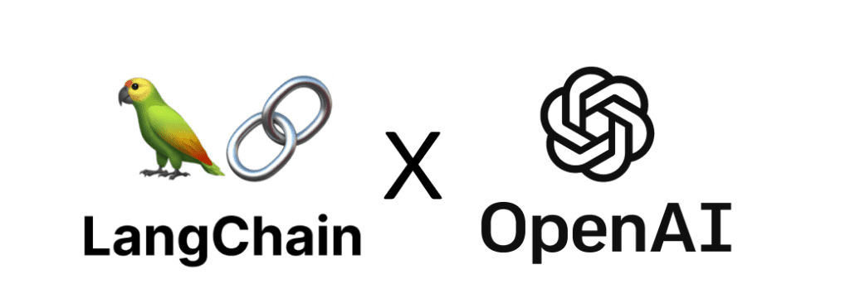
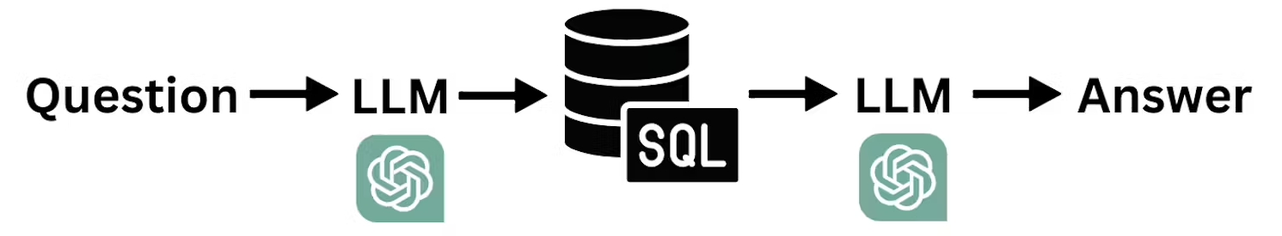
NL2SQL : Natural Language to SQL
Chatbot Web Application

